Slide 1
Wat is het verschil tussen Rust en C++?
Rust vs c++

Slide 2
Zoektermen
C++ vs Rust
Difference between rust and c++
Rust and c++
Rust or C++
C++
Rust
Difference

Slide 3
Auteurs
Brian Anderson
Lars Bergstrom
David Herman
Josh Matthews
Keegan McAllister
Jack Moffitt
Simon Sapin
Manish Goregaokar
https://arxiv.org/pdf/1505.07383.pdf

Slide 4
Doelgroep
Onderzoekers willen weten of rust een goede vervanging van C++ in browser engines.
Managers
browser gebruikers

Slide 5
Literatuurlijst
21 bronnen
[HPHF14] Hammer, M. A., K. Y. Phang, M. Hicks, and J. S. Foster. Adapton: Composable, demand-driven incremental computation. In Proceedings of the 35th ACM SIGPLAN Conference on Programming Language Design and Implementation, PLDI ’14, Edinburgh, United Kingdom, 2014. ACM, pp. 156–166.

Slide 6
Actualiteit
26 Mei 2015
[HPHF14] Hammer, M. A., K. Y. Phang, M. Hicks, and J. S. Foster. Adapton: Composable, demand-driven incremental computation. In Proceedings of the 35th ACM SIGPLAN Conference on Programming Language Design and Implementation, PLDI ’14, Edinburgh, United Kingdom, 2014. ACM, pp. 156–166.

Slide 7
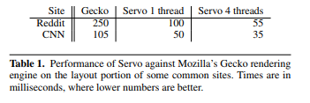
Beschrijving onderzoeksmethode
“Table 1 shows a preliminary comparison of the performance of the layout stage (described in Section 2) of rendering several web sites in Mozilla Firefox’s Gecko engine compared to Servo, taken on a modern MacBook Pro”

Slide 8
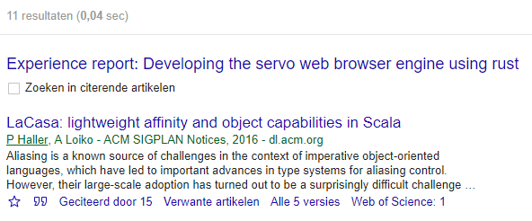
Controle
Dit document is 11 geciteerd in andere artikelen

